Slide 1
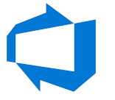
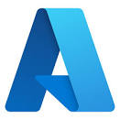
Course Content

Slide 2
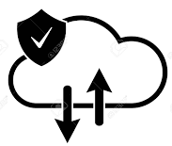
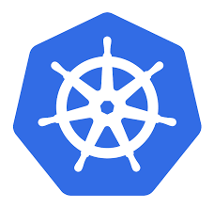
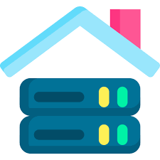

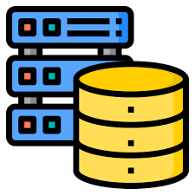
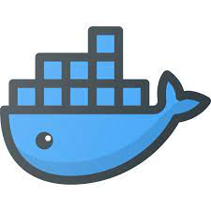
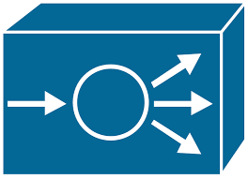
Docker & Kubernetes
Introduction to IT
Kubernetes
Client-Server Architecture
On-premises
Virtual Machines
Pods, Services & Ingress
ConfigMaps & Secrets
Volumes
Deployments & Replicas
Components
Architecture
Installation
Commands
YAML
Taints & Tolerations
Affinities
RBAC
Ingress
Persistent Volumes
NFS provisioner
StatefulSets
Resource Management
Auto Scaling
Deployment Strategies
Service Mesh- ISTIO
On-Premise Deployment
Linux
Storage
Application server installation
Web server installation
Database server installation
Booting
Commands
Permissions
Types of storages
Disk Management
LVM
Docker
Networking
Types of networks
IP Address
Subnetting
Routing
DNS,DHCP,NAT
VM Networking
NFS
Introduction to docker
Docker Registry
Docker Networking
Docker Volumes
Docker Installation
Moving On-premise setup to docker

Slide 3


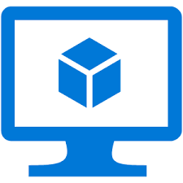
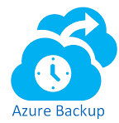
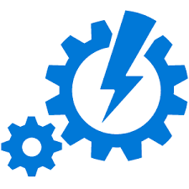
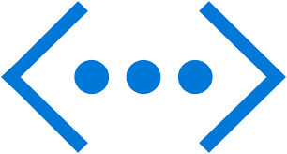
Azure
Introduction to Azure
Azure Storage
Azure Compute
On Premise Active Directory
Azure Active Directory
Cloud Computing
Azure Pricing & Structure
Azure RBAC & AD Roles
Azure policy
Azure Regions & Zones
Introduction
Redundancy
Blobs
File Shares
Storage SLA & Pricing
Networking Overview
Virtual Machines
Load Balancer
Virtual Machine Scale Sets
App Services
Azure Kubernetes Services
Backup & Monitoring
Networking
Automation
Virtual Machine Backup
Azure Site Recovery
Azure Monitoring
Log Analytics Agent
Application Insights
Azure Alerts
Private Endpoints & Service Endpoints
Hub & Spoke Model
Azure Firewall
Azure VPN Gateway
Azure Express Route
ARM Templates
Azure Functions
Azure Automation Accounts
Desired State Configurations
Logic Apps

Slide 4
Azure DevOps
Azure DevOps
Azure DevOps Overview
Azure Boards
Azure Repos
CI/CD Pipelines for dotnet
CI/CD Pipelines for docker & Kubernetes
CI/CD Pipelines for ARM Templates (Infrastructure as Code)
Terraform Overview
CI/CD Pipelines for Terraform
Azure Artifacts
Azure Test Plans
Azure Load Testing

Slide 5
Course Coverage Timeline
(4 Weeks)
(4 Weeks)
(2 Weeks)

Slide 6
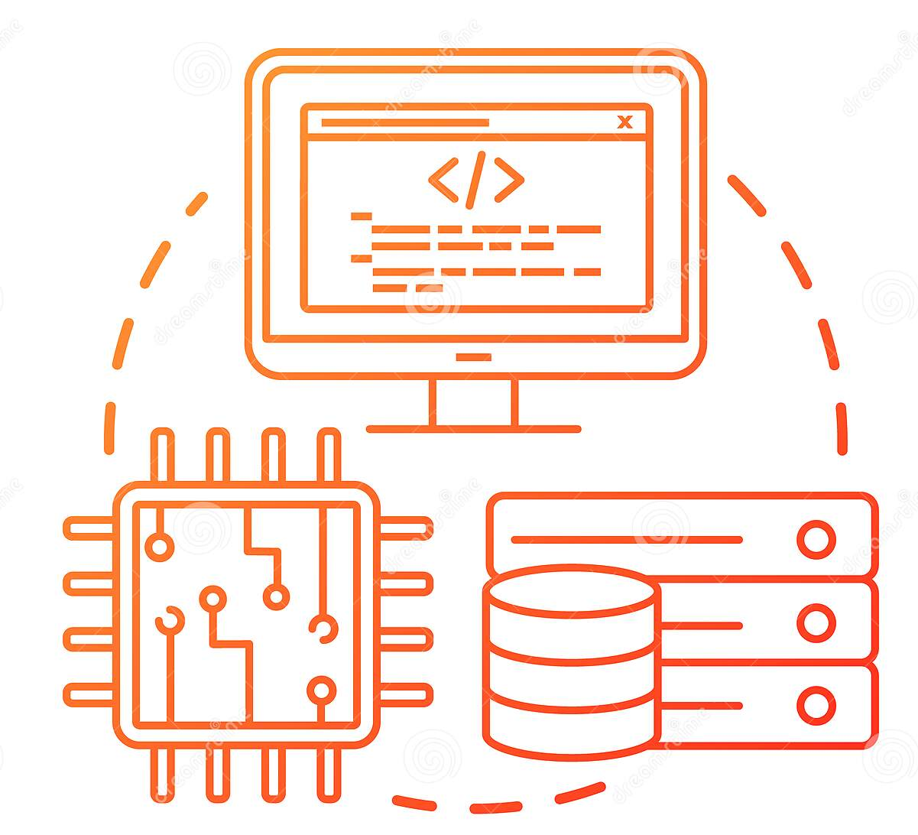
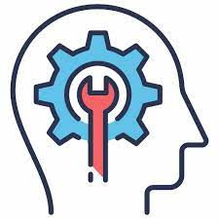


Outcomes of the Training
Understanding of why IT industry today is in the way it is ?
Technical Knowledge
Confidence to pick up any technology and master it
Understanding of Roles & Responsibility, work culture

Slide 7
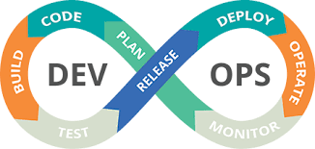
Azure DevOps

Slide 8





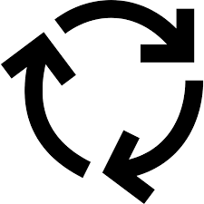
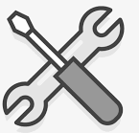

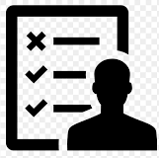
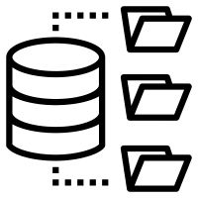


DevOps Lifecycle
Customer comes with requirements
Business analysts/product owner translates requirements into smaller units called backlogs
Developers picks up backlog items/bugs and starts development
Engineering team/SCRUM master does the capacity planning and sprint planning
Once developers finish the code, they
Build and test in their local
Get it reviewed
Commits the code to central repo
Business users test UAT environment
If they find any expectation mismatch then report it to product owner
Testing team does test planning
Testing team tests the deployments and logs defects
Once testing team is satisfied they promote the deployment to UAT
Central
Repo
Once business team is satisfied they promote the deployment to PROD
PROD
VMs
Kubernetes
PAAS Services
UAT
VMs
Kubernetes
PAAS Services
DEV
VMs
Kubernetes
PAAS Services
Deployment Environments
Build and test in central place with the entire code
Save the build output in central place
Stage wise deploy

Slide 9
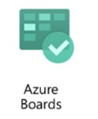
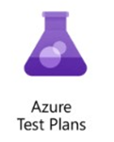
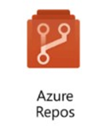
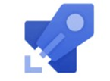
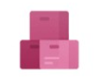
DevOps Lifecycle
Customer comes with requirements
Business analysts/product owner translates requirements into smaller units called backlogs
Developers picks up backlog items/bugs and starts development
Azure Boards
Engineering team/SCRUM master does the capacity planning and sprint planning
Once developers finish the code, they
Build and test in their local
Get it reviewed
Commits the code to central repo
Business users test UAT environment
If they find any expectation mismatch then report it to product owner
Testing team does test planning
Testing team tests the deployments and logs defects
Once testing team is satisfied they promote the deployment to UAT
Azure
Repo
Azure Test Plans
Once business team is satisfied they promote the deployment to PROD
PROD
VMs
Kubernetes
PAAS Services
UAT
VMs
Kubernetes
PAAS Services
DEV
VMs
Kubernetes
PAAS Services
Azure
Build
Pipelines
Deployment Environments
Build and test in central place with the entire code
Save the build output in central place
Stage wise deploy
Azure Release Pipelines
Azure Artifacts

Slide 10
Features of Azure DevOps
Azure Boards delivers a suite of Agile tools to support planning and tracking work, code defects, and issues using Kanban and Scrum methods
Azure Repos provides Git repositories or Team Foundation Version Control (TFVC) for source control of your code.
Azure Pipelines provides build and release services to support continuous integration and delivery of your apps.
Azure Artifacts allows teams to share Maven, npm, and NuGet packages from public and private sources and integrate package sharing into your CI/CD pipelines.
Azure Test Plans provides several tools to test your apps, including manual/exploratory testing and continuous testing.

Slide 11
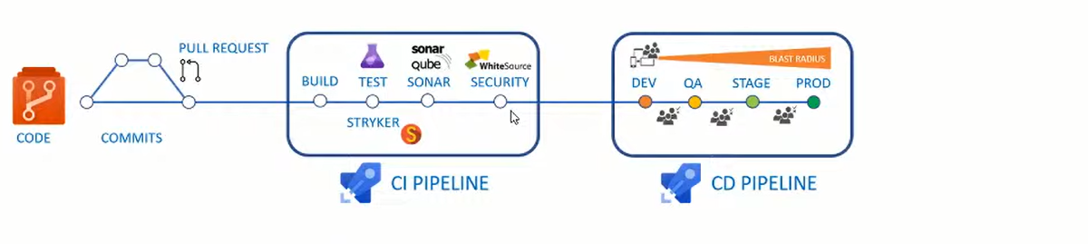
CI/CD Overview

Slide 12
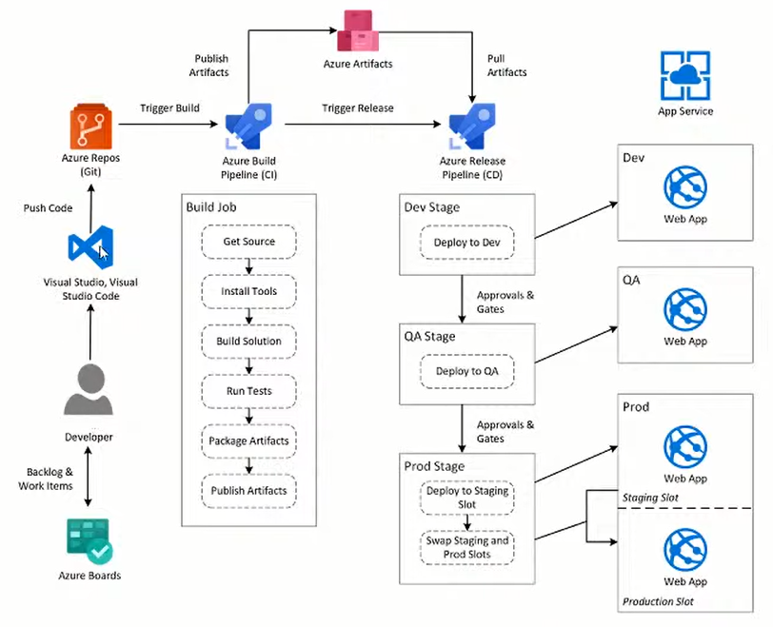
CI/CD Lifecycle

Slide 13


